Slide 1
What motivates people to study abroad?
Sergey Loginov
Abdimalik Gafirov

Slide 2
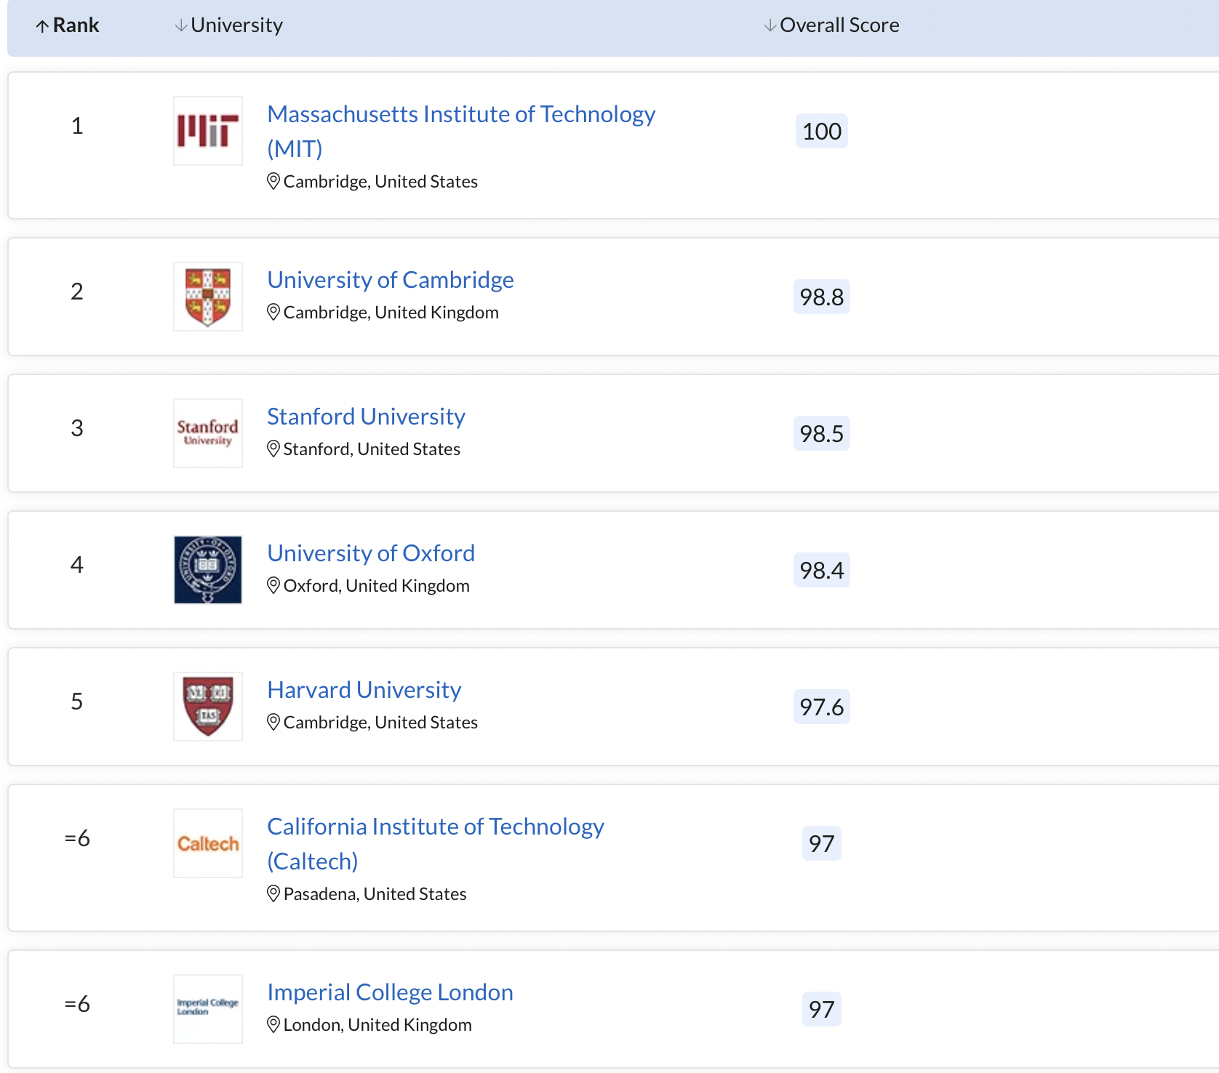
Quality of education

Slide 3
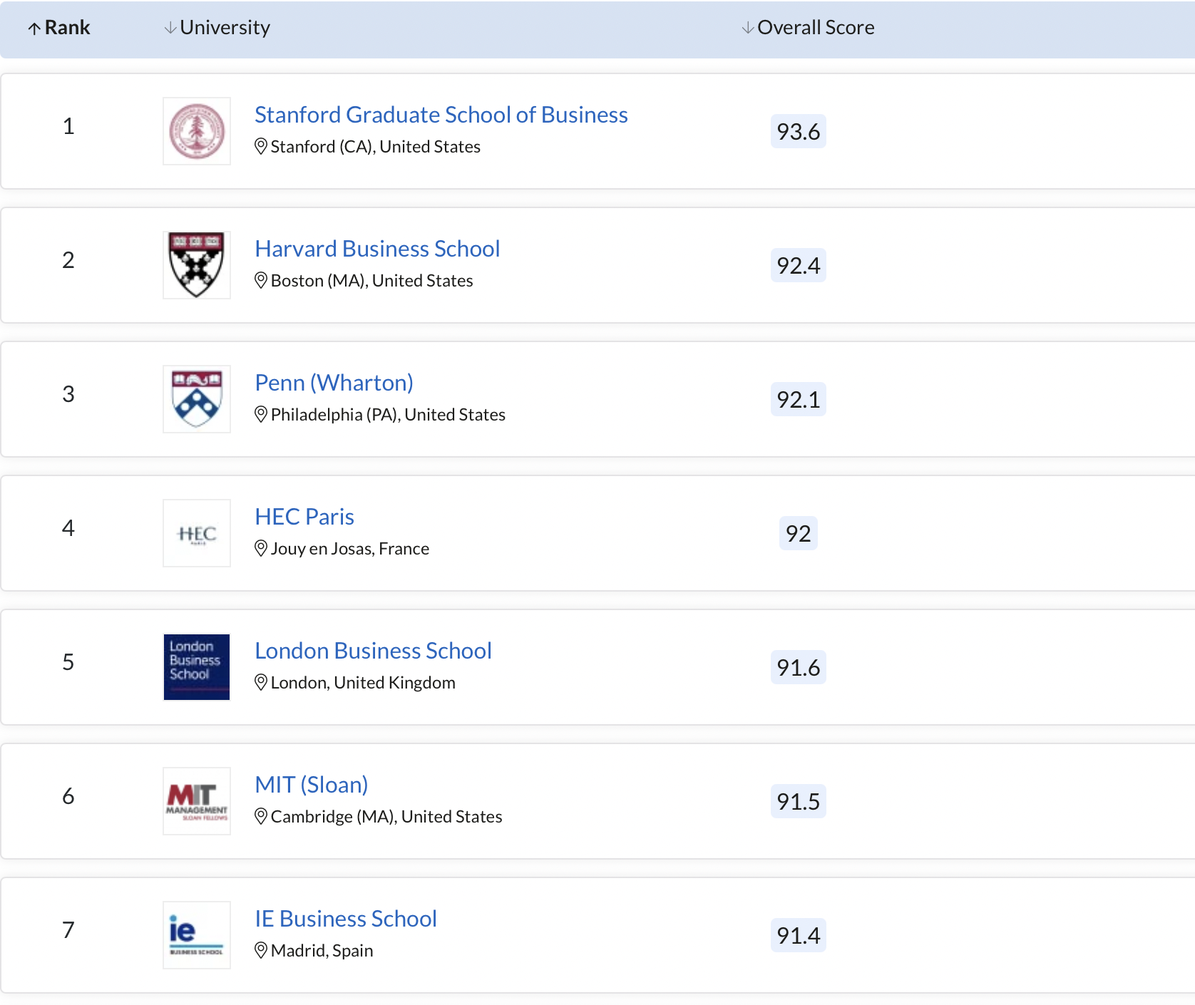
MBA

Slide 4
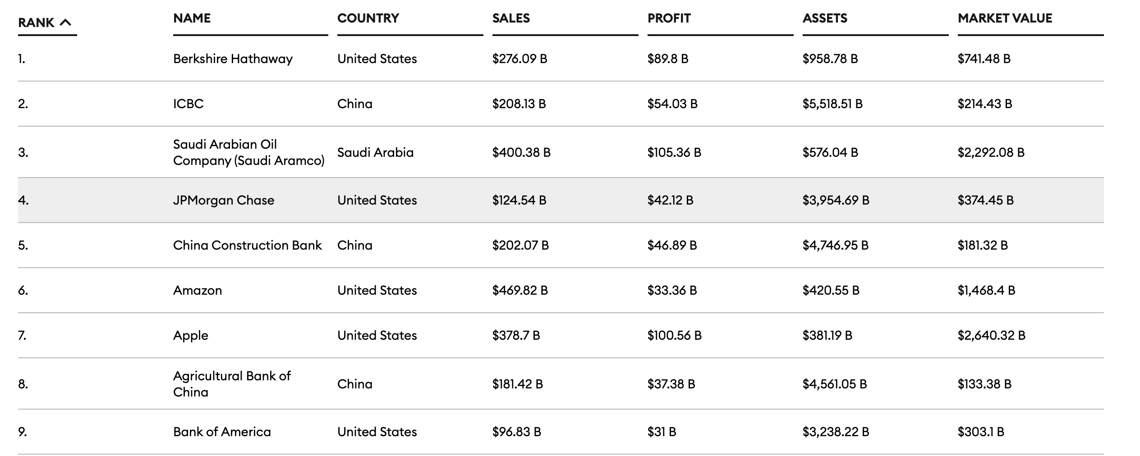
Work abroad

Slide 5
Work abroad
Chevening Scholarship (UK, full, for Masters)
Fulbright Scholarships (USA, full)
Endeavour Postgraduate Awards (for Masters and PhD level in Australia, up to 275000 AUD)
Eiffel Excellence Scholarship Programme (France, up to 1800 euro for month)
Commonwealth Scholarship (Full, for Masters and PhD students in the UK)

Slide 6
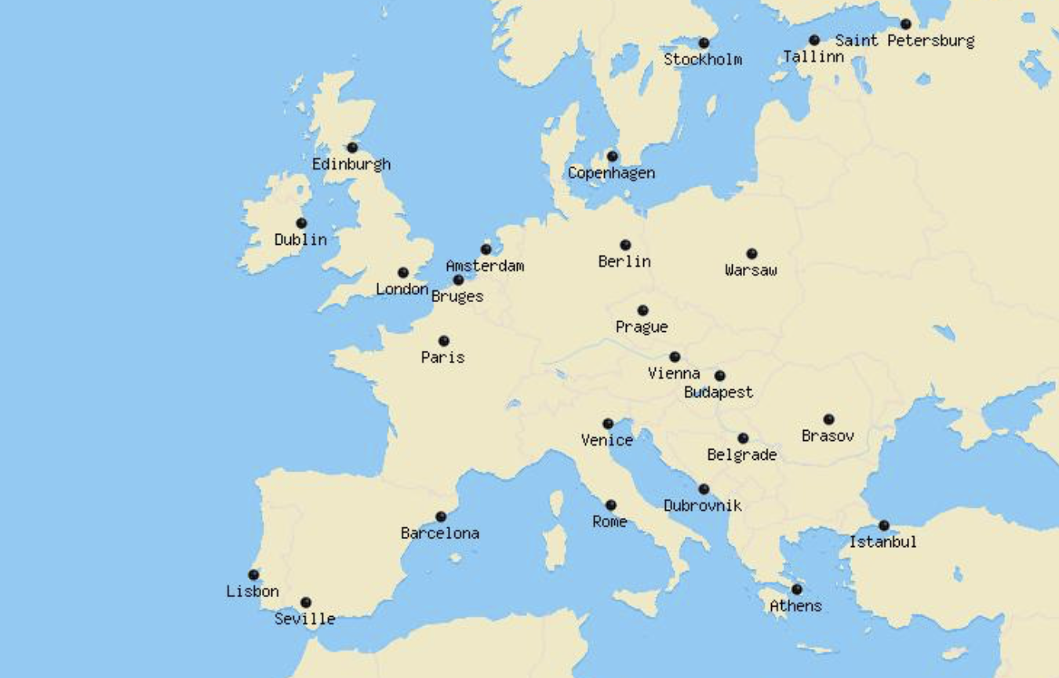
Travel

Slide 7
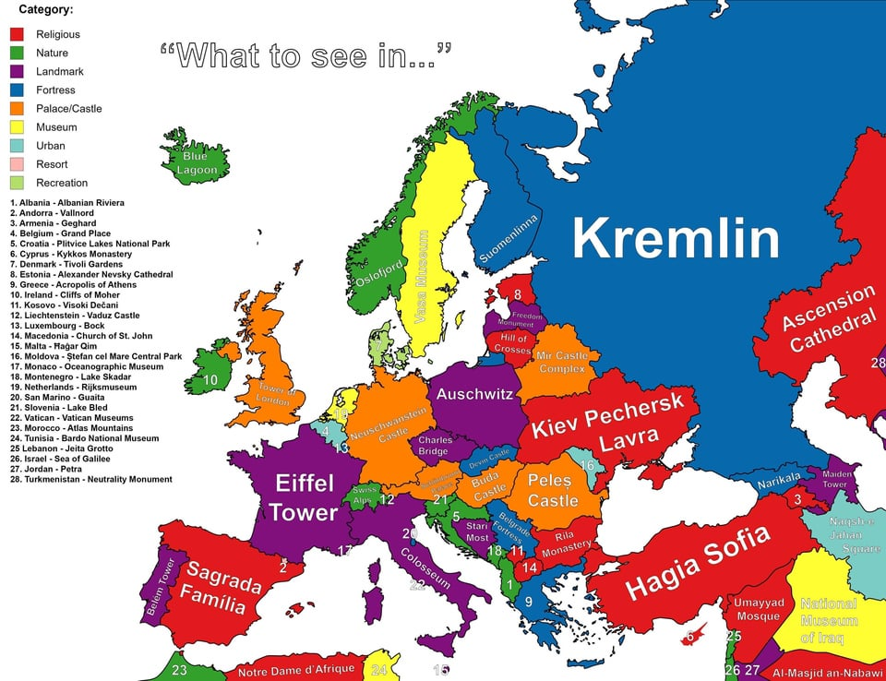
Travel

Slide 8


Culture and language

